Slide 1
Command Design Pattern
Brett Recker
Radwan Albadawi

Slide 2
Story
A behavioral design pattern in which an object is used to encapsulate all information needed to perform an action or trigger an event at a later time.
This information includes the method name, the object that owns the method and values for the method parameters.
Client
TurnTVOn
Invoker
DeviceButton.press()
Command
TurnTVOn.execute()
Receiver
Television.On
Notes:
There are four terms used when explaining Command Design Pattern. Using the Turn TV On example, the client defines the device or TV and a command to be issued (TurnTVOn). Let’s say our DeviceButton Invoker class has a press method. When the client calls this press method the invoker calls the execute command on the Command Object. Lastly, this execute method will call the Receiver and in our case will turn the TV on.

Slide 3
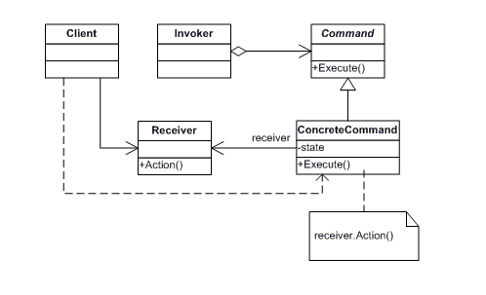
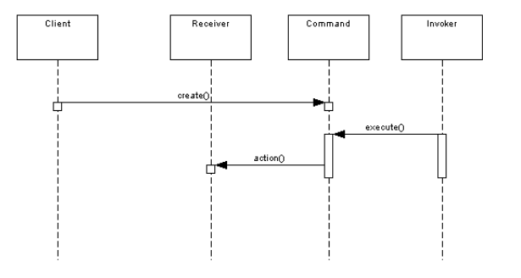
UML Design
Notes:
The Command object declares an interface for all commands by providing a simple execute method. The Client creates ConcreteCommands and sets a Receiver for each command.
The ConcreteCommand class extends Command and defines the relationship between the Receiver object and an action. It also implements a Execute method by calling the corresponding action on the receiver. In our TV example the receiver would be the TV and it’s action is Power On.
Lastly, the invoker holds the command and can get it to execute a request by calling its execute method. This would be the TurnTVOn method in our example from the last slide with would set power the TV on.
This design is beneficial as the creation of a command and its execution are not dependent on each other. This means that the Command instance can be instantiated by Client, but run sometime later by the Invoker, and the Client and Invoker don’t need to know about each other.
This pattern also allows for extensibility as we can add a new command without changing the existing code. It also supports a queue system so that a sequence of commands can be implemented.

Slide 4

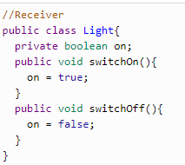
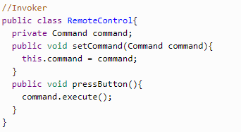
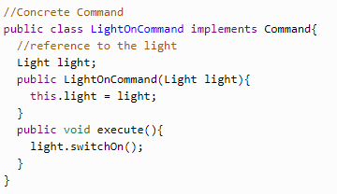
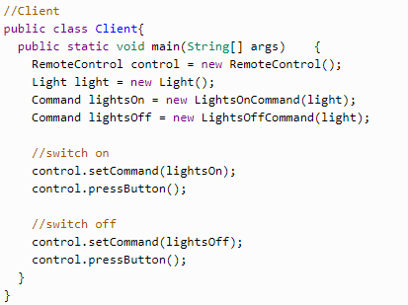
Code
Notes:
First, we have our command interface for all commands which implements a simple execute method.
Next, the concretecommand class LightsOnCommand, extends command in this case to switch a light on through the execute method.
Then our receiver class contains the logic to carry out the command. Here we define the receiver action of setting the on attribute of the light.
Our Invoker, or caller, in this case is a remote control which gets the command to execute by calling the execute method.
Lastly, the client class is set up to use the caller class to invoke the command.

Slide 5
Quiz
What are the four main classes in the Command Design Pattern?
Is the command created and executed by the same class?
What is the role of the receiver?
Notes:
Client, Invoker, Command, Reciever
No, commands are created by the client and executed by the invoker.
Accepts the request and performs a specific action on it.

Slide 6
Sources
https://en.wikipedia.org/wiki/Command_pattern
https://dzone.com/articles/design-patterns-command
https://www.youtube.com/watch?time_continue=118&v=7Pj5kAhVBlg

